Slide 1
Project Topic
AI-Driven Mental Health Companion
Presented By
Pratik Deepak Bandpatte [24129]
Neha Raju Medar [24147]
Devesh Narendra Mahajan [24135]
Vishal Ajay Wagh [24126]
Under the Guidance of
Mrs. Mayuri Fegade

Slide 2
Table of Contents
Introduction
Motivation Behind This Topic
Literature Survey
Research Gap Identification
Problem Statement, Objective & Scope
Methodology ( Proposed system architecture, module names, algorithms)
Cost Estimation
Risk Identification:
Risk Analysis
Risk Mitigation, Monitoring, Management
System Requirements:
Database Requirements
Software Requirements
Hardware Requirements
UML Diagrams:
Use Case Diagram
Class Diagram
Sequence Diagram
Conclusion

Slide 3
Introduction
In today’s fast-paced world, mental health challenges have become increasingly prevalent, affecting millions globally. Addressing these challenges requires innovative solutions that are accessible, scalable, and effective. The "AI-Driven Mental Health Companion" project aims to leverage advancements in Artificial Intelligence (AI) and Machine Learning (ML) to create a virtual assistant that supports mental well-being. This AI-powered companion will utilize Natural Language Processing (NLP) and Generative AI to interact with users, provide emotional support, and offer actionable insights based on real-time sentiment analysis.

Slide 4
Motivation Behind the Topic
The motivation behind developing an AI-driven mental health companion stems from the growing need for accessible mental health resources. Traditional mental health services are often limited by availability, cost, and stigma. AI-driven solutions offer a way to provide continuous, personalized support to individuals, overcoming barriers such as long wait times and geographic limitations. By harnessing the power of NLP and conversational AI, this project aims to create a tool that not only supports users in managing their mental health but also promotes mental wellness in a non-judgmental and empathetic manner.

Slide 5
Literature Survey
Sr. No. | Paper Details | Problem Discussion | Algorithm /Technique used | Parameter Consider | Result
1 | KrishnaVani :-An AI-Powered Companion | The paper highlights increasing mental health issues among students aged 18 to 24, including depression and suicidal thoughts. It introduces KrishnaVani, an AI companion offering confidential emotional support and practical advice. | Rasa Framework, TensorFlow, Natural Language Understanding (NLU), Advanced NLP Techniques | Accuracy and Relevance, User Satisfaction, Comprehensive Scope, Natural Language Understanding (NLU), User Customization and Personalization | KrishnaVani excels with 92% accuracy and 87% user satisfaction, surpassing competitors in addressing a range of student mental health issues. It receives high praise for its intuitive design and empathetic responses.
2 | Chatbot for Mental Well-being | The project aims to create a 24/7 generative chatbot for emotional expression and stress relief, enabling users to track their mood over time. | It employs an SVM classifier for mood detection and a Seq2Seq model with RNNs for generating responses based on tokenized input. | The system uses user mood from the SVM classifier and tokenized input vectors, with an attention mechanism to improve response generation. | The Seq2Seq model achieved 96.53% accuracy and 90.69% validation accuracy after 30 epochs, providing a user-friendly interface for mood classification and response generation.

Slide 6
Sr. No. | Paper Details | Problem Discussion | Algorithm /Technique used | Parameter Consider | Result
3 | ARTIFICIAL INTELLIGENCE-BASED CHATBOT FOR MENTAL HEALTH | Depression affects 264 million people globally, with high stress and anxiety in those aged 15-29, often leading to unresolved mental health issues.. | The AI chatbot uses machine learning and NLP, including sentiment analysis and entity recognition, to interact with users and provide advice. | It evaluates users' mental health through targeted questions to tailor responses to their needs. | Chatbots like Woebot, Wysa, and Joy show promise in offering emotional support and resources, improving access to mental health care.
4 | A Mental Health and Well-Being Chatbot: User Event Log Analysis | The study analyzes user interactions with a chatbot designed for mental health support, focusing on understanding user engagement patterns and retention over time. It identifies different user types based on their interaction frequency and duration of use. | The k-means clustering algorithm was employed to categorize users into distinct groups based on their behavioral usage of the chatbot. Principal component analysis was also utilized to visualize the clustering results and reduce the dimensionality of the data. | Key parameters for clustering included the number of unique days users accessed the chatbot, tenure (the duration from first to last use), mood logs completed, conversations accessed, and total interactions with the chatbot. | The analysis identified three user clusters: "abandoning users" (81.7%), "frequent transient users" (2.2%), and "sporadic users" (16.1%), with abandoning users displaying the lowest engagement.

Slide 7
Research Gap Identification
While numerous mental health apps and chatbots exist, many lack depth in emotional intelligence, personalized interactions, and real-time adaptation to user needs. The primary research gaps include:
Limited Emotional Intelligence: Many existing solutions fail to effectively understand and respond to the nuances of human emotions.
Scalability and Personalization: Few tools offer personalized experiences that adapt over time based on individual user interactions.
Integration of Generative AI: There is a lack of advanced AI models that combine generative capabilities with mental health support, resulting in less engaging and supportive interactions.

Slide 8
Problem Statement
Despite increasing awareness of mental health issues, many people encounter barriers to accessing timely and personalized support due to limitations in traditional services. This project aims to address these challenges by developing an AI-powered mental health companion that uses advanced natural language processing to offer real-time and empathetic support, thereby improving access to mental health support and enhancing overall well-being.

Slide 9
Scope and Objective
Scope:
Demand Forecasting: Use models to predict customer demand accurately.
Inventory Management: Optimize material ordering to avoid excess inventory.
Supply Chain Collaboration: Improve coordination with suppliers for better waste management.
Lean Practices: Apply methods to reduce waste and improve efficiency.
Real-Time Monitoring: Use technology to track and adjust inventory and production dynamics.
Objective:
Improve Demand Forecasting: Use advanced techniques to accurately predict customer demand.
Optimize Inventory Management: Calculate the exact amount of materials needed to reduce excess inventory.
Enhance Supply Chain Collaboration: Work closely with suppliers to streamline operations and reduce waste.
Implement Lean Practices: Apply methods like 5S and Kaizen to eliminate waste in the production process.
Utilize Real-Time Monitoring: Use technology to monitor inventory and production in real-time and make quick adjustments.

Slide 10
Methodology
The project will be executed through the following methodology:
1. Literature Review and Requirements Analysis:
- Review existing mental health tools and AI applications.
- Conduct surveys and interviews to understand user needs and preferences.
2. System Design:
- Architectural Design: Develop a high-level architecture for the AI-driven companion including components for NLP, sentiment analysis, and user interaction.
- UML Diagrams: Create Use Case Diagrams, Class Diagrams, and Sequence Diagrams to model the system’s functionalities and interactions.

Slide 11
3.Development:
-NLP and Sentiment Analysis:Implement algorithms for natural language understanding and sentiment detection.
- Generative AI:Integrate generative models to create engaging and contextually relevant responses.
- Frontend and Backend Development: Develop a user-friendly interface and robust backend to support real-time interactions.
4. Testing and Evaluation:
- Perform rigorous testing including functional, usability, and emotional response testing.
- Gather user feedback for iterative improvements.
5. Deployment and Monitoring:
- Deploy the companion on a web platform.
- Continuously monitor performance and user interactions to refine the system.

Slide 12
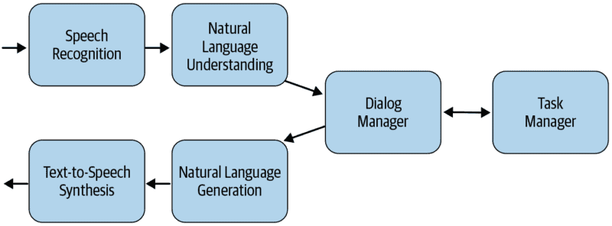
Proposed System Architecture

Slide 13
Proposed Module Names
User Management Module
Chat Interface Module
AI Engine Module
Mental Health Resources Module
Therapeutic Interventions Module
Analytics and Insights Module
Data Management Module
Notifications Module
Ethics and Privacy Module
API Integration Module
Admin Dashboard Module

Slide 14
Algorithms (which maybe used)
NLP Algorithms:
Naive Bayes
Support Vector Machines (SVM)
BERT
VADER
LSTM
Spacy NER
TextRank
GPT
Machine Learning Algorithms:
Random Forest
Logistic Regression
K-Means Clustering
Hierarchical Clustering
Q-Learning
Recommendation Algorithms
Collaborative Filtering
Content-Based Filtering
TF-IDF
Behavioral and Predictive Analytics Algorithms:
Linear Regression
Decision Trees
Time Series Forecasting
Isolation Forest
Deep Learning Algorithms
Convolutional Neural Networks (CNNs)
Recurrent Neural Networks (RNNs)
Transformer Models
Ethics and Bias Mitigation Algorithms:
Adversarial Debiasing
Fairness Constraints
Data Privacy and Security Algorithms:
AES (Advanced Encryption Standard)
RSA (Rivest–Shamir–Adleman)
k-Anonymity
Differential Privacy
User Engagement and Interaction Algorithms:
Thompson Sampling
Multi-Armed Bandit algorithms
Gradient Boosting Machines (GBMs)

Slide 15
Cost Estimation
The cost estimation for the project involves:
Development Costs: Cost for AI tools, developing, and UX/UI designing.
Technology Costs: Licenses for AI tools, cloud computing services, and software development platforms.
Testing Costs: Resources for user testing, including recruitment and compensation for participants.
Deployment Costs: Expenses for server hosting, maintenance, and security.

Slide 16
Risk Identification
Risk Mitigation: Implement strong encryption (AES, RSA), regular security audits, and bias mitigation techniques.
Risk Monitoring: Use real-time monitoring and anomaly detection (Isolation Forest) to identify issues.
Risk Management: Establish an incident response plan and ensure compliance with regulations like GDPR.

Slide 17
Risk Identification
Potential risks include:
Technical Challenges: Difficulties in achieving high accuracy in sentiment analysis and generating empathetic responses.
Data Privacy: Ensuring the security and confidentiality of user data.
User Acceptance: Resistance from users in trusting or adopting an AI-driven mental health companion.
Regulatory Compliance: Adhering to mental health regulations and standards.

Slide 18
System Requirements
Software Requirements:
Windows/Ubuntu OS
Python3 and suitable IDE
Flask/ Django, Required Libraries
Database Requirements:
MySQL/ SQLite
Hardware Requirements:
i5 Processor
256 SSD/1TB HDD
8GB RAM
GPU 4GB VRAM with CUDA support.

Slide 19
UML Diagrams
Use Case Diagram:
Illustrates interactions between users and the mental health companion (e.g., User interacts with the chatbot, User receives feedback, etc.).
Class Diagram:
Details the structure of the system, including classes for User, Chatbot, Sentiment Analysis, and Response Generator.
Sequence Diagram:
Depicts the sequence of interactions during a typical user session, from initial greeting to response generation and feedback collection.

Slide 20
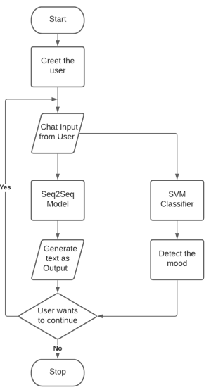
UML Diagrams

Slide 21
Conclusion
The AI-Driven Mental Health Companion project represents a significant advancement in the field of mental health support. By integrating AI, NLP, and generative capabilities, the project aims to provide users with a highly personalized, empathetic, and effective tool for managing their mental well-being. Addressing current gaps in emotional intelligence and personalization, this project has the potential to make mental health support more accessible and impactful. Through careful planning, development, and testing, the project aims to deliver a solution that not only meets but exceeds user expectations in mental health support.

Slide 22
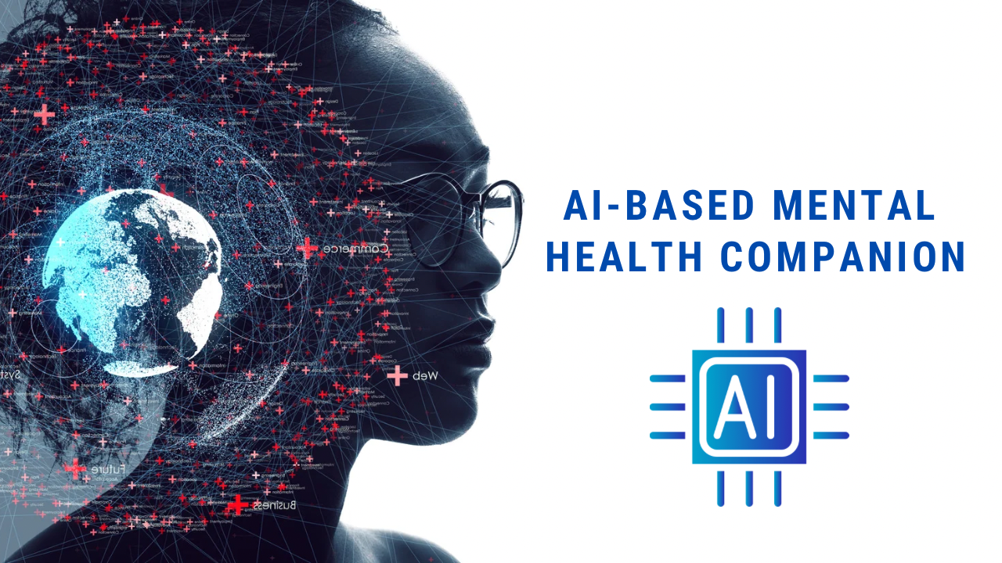
Thank You..!

